Slide 1
Amazon Aurora
The Relational Database Management system by Amazon

Slide 2
Index
Topics | Slide Number
Introduction and brief | 3-19
Performance | 20-26
Advantages | 27-33
Disadvantages | 34-35
Customers, use cases and applications | 36-42

Slide 3
Introduction to Amazon Aurora
Aditya Kangune - 23365

Slide 4
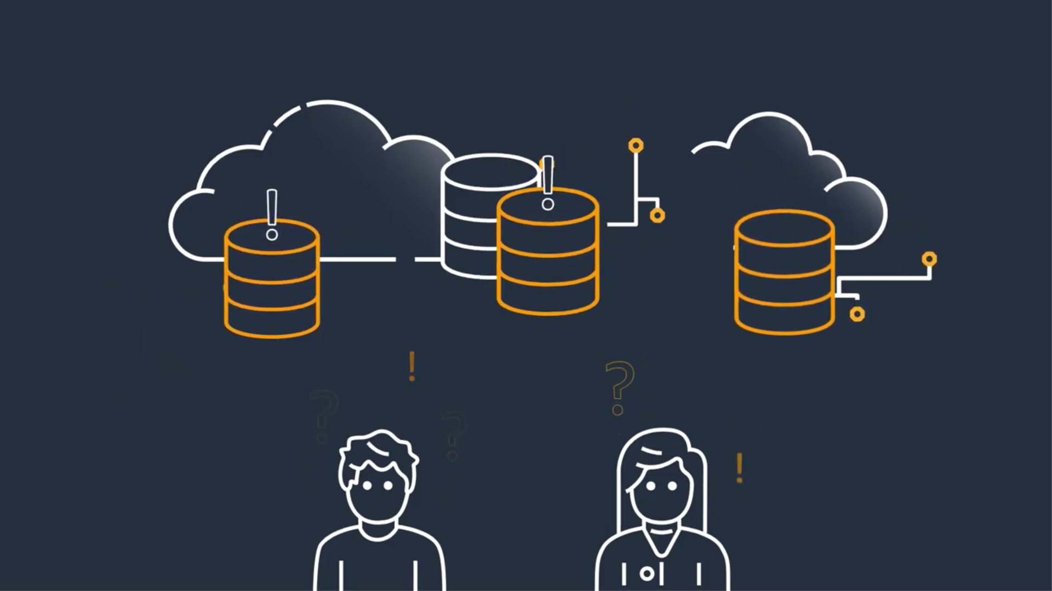

Slide 5
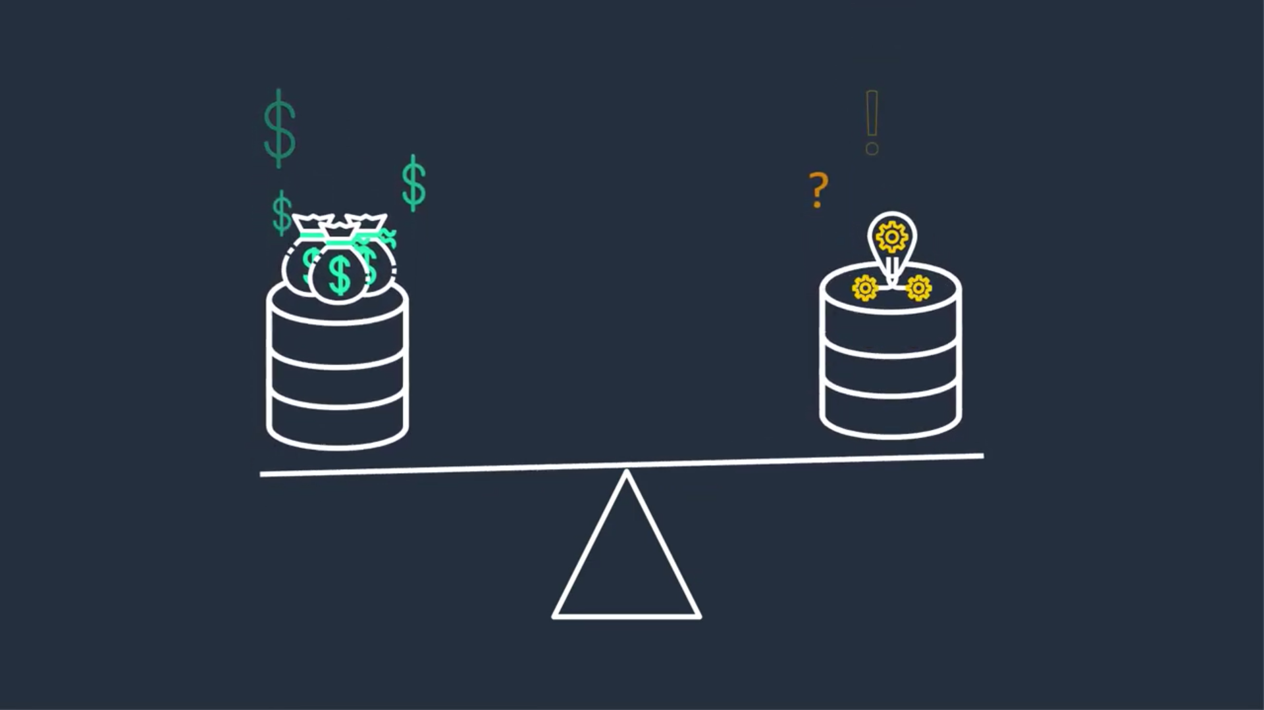

Slide 6
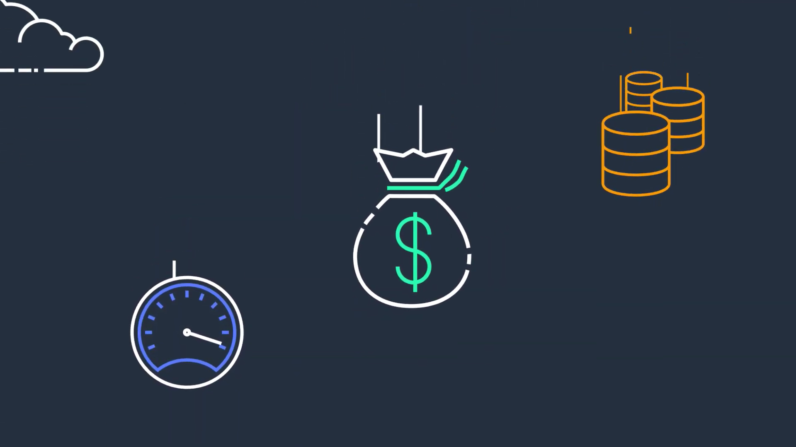

Slide 7
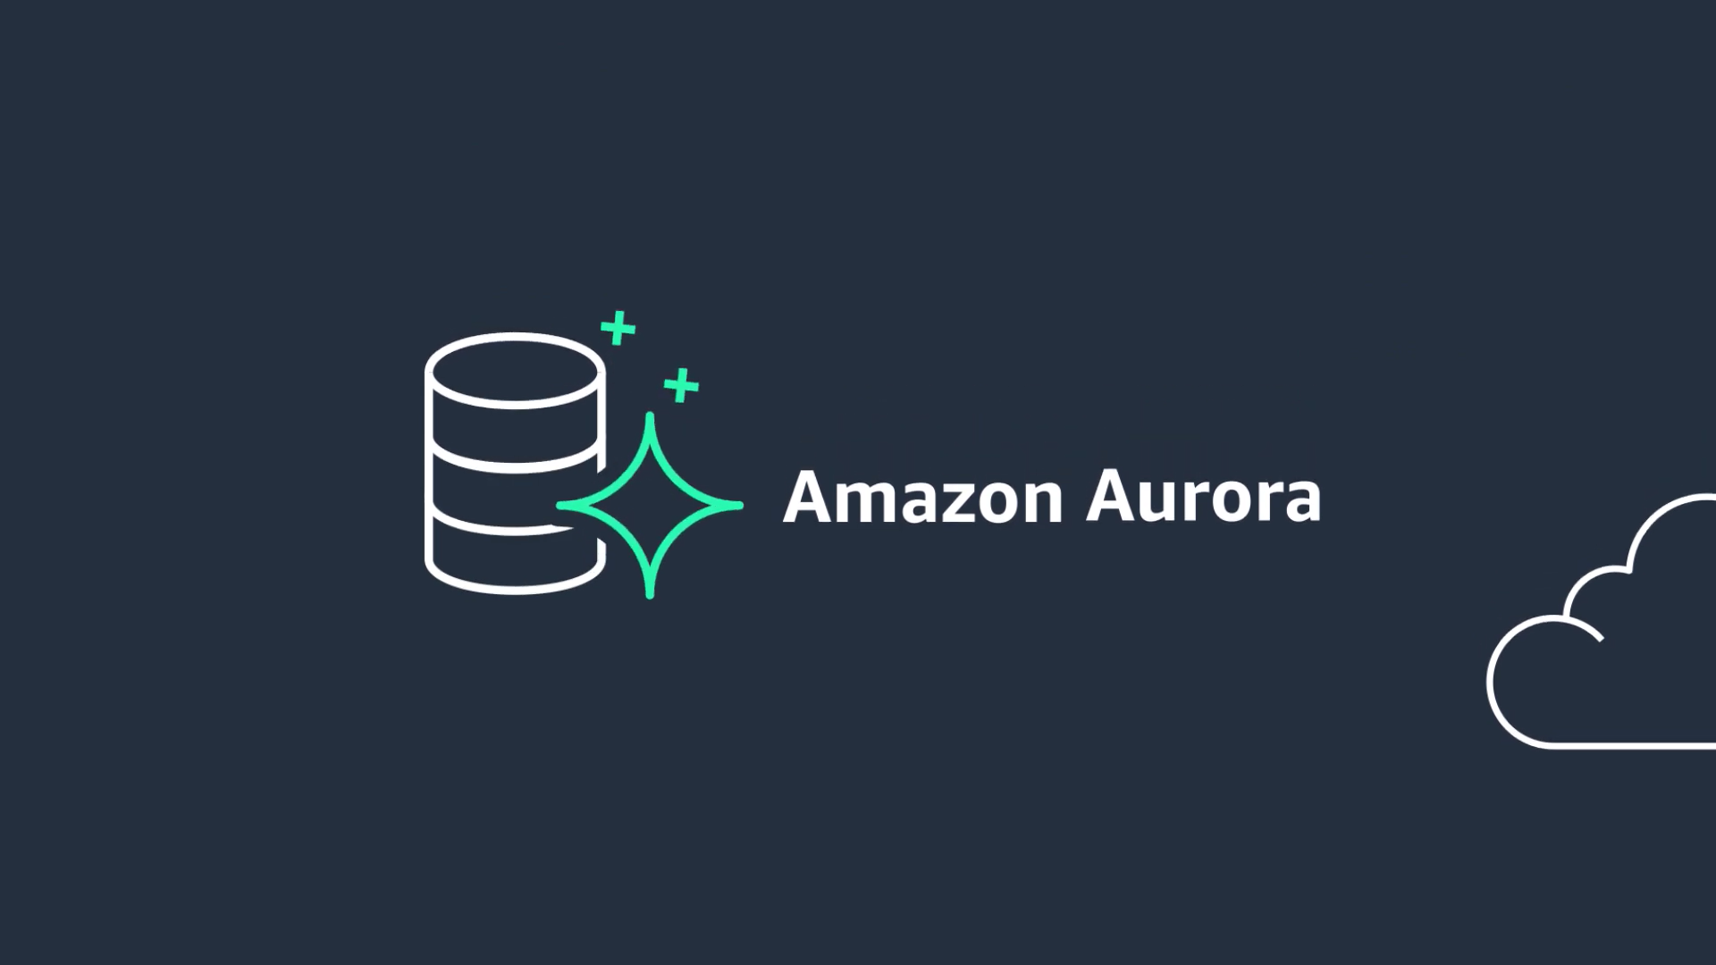

Slide 8
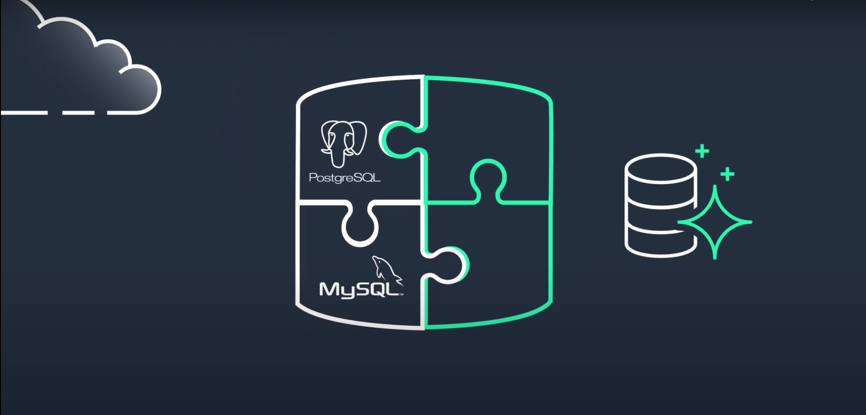

Slide 9
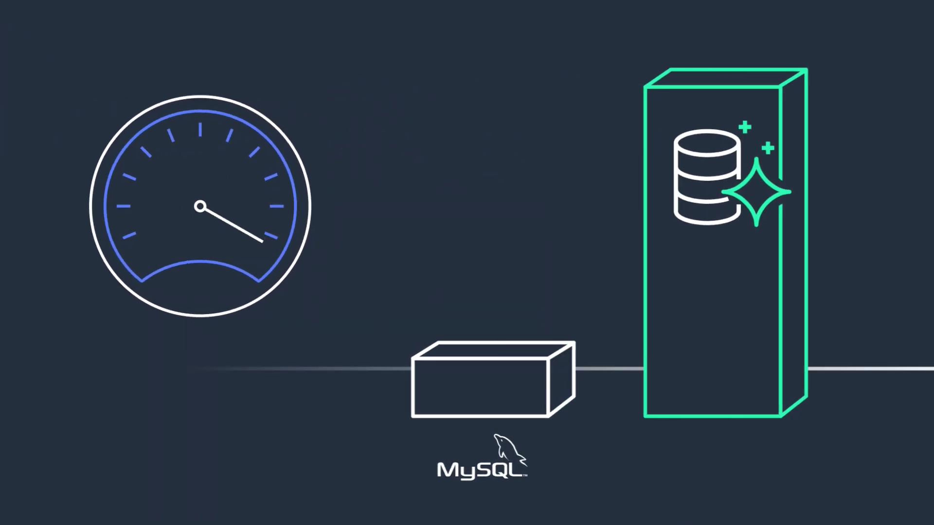

Slide 10
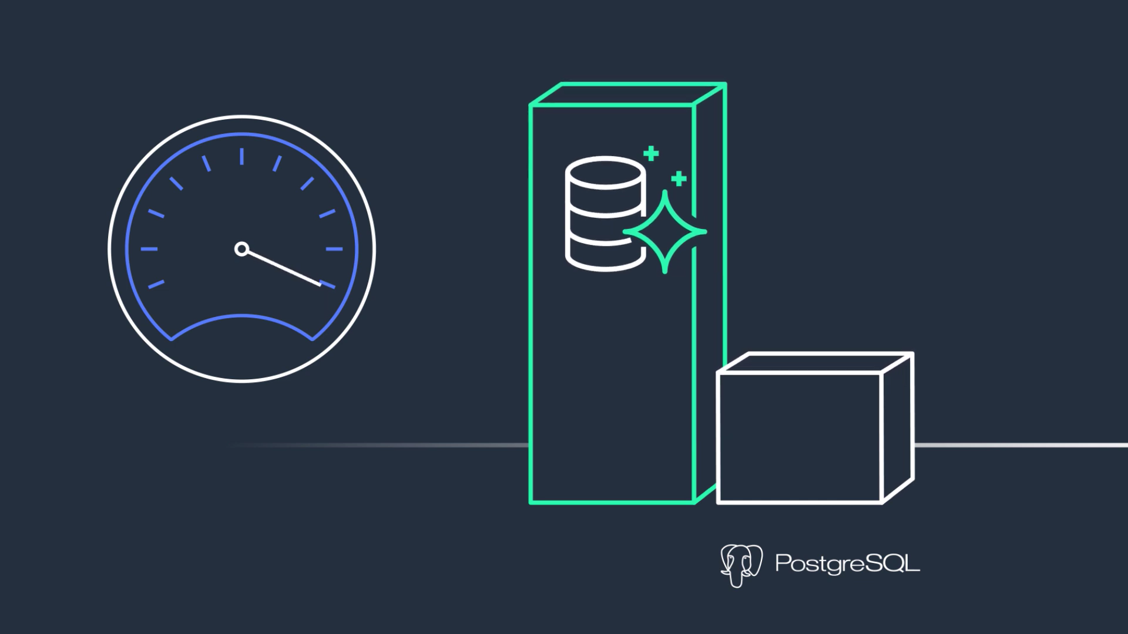

Slide 11
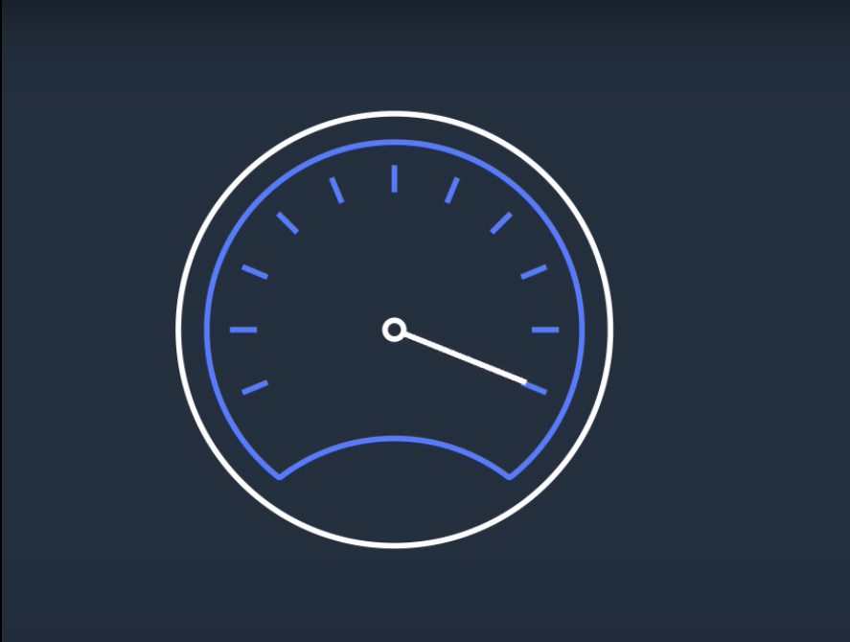

Slide 12
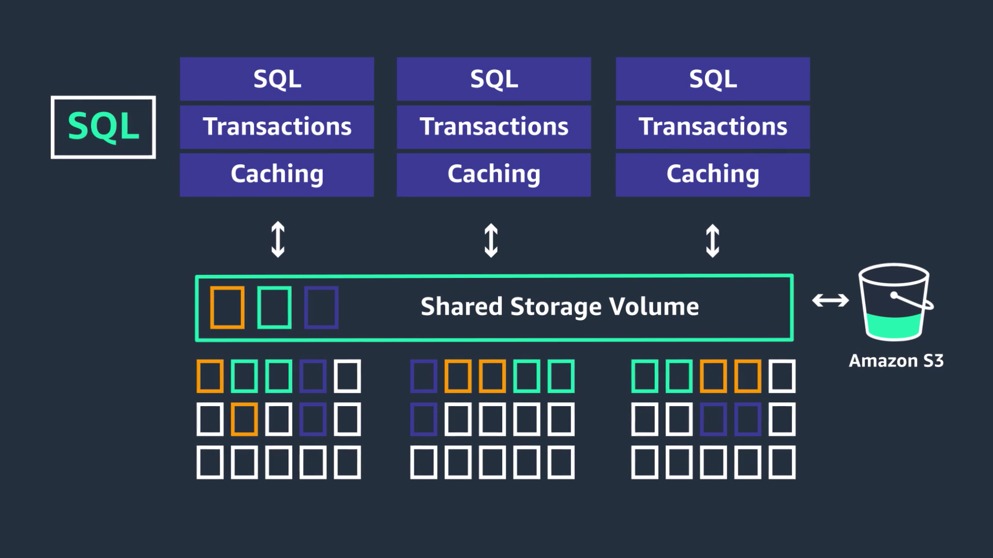

Slide 13
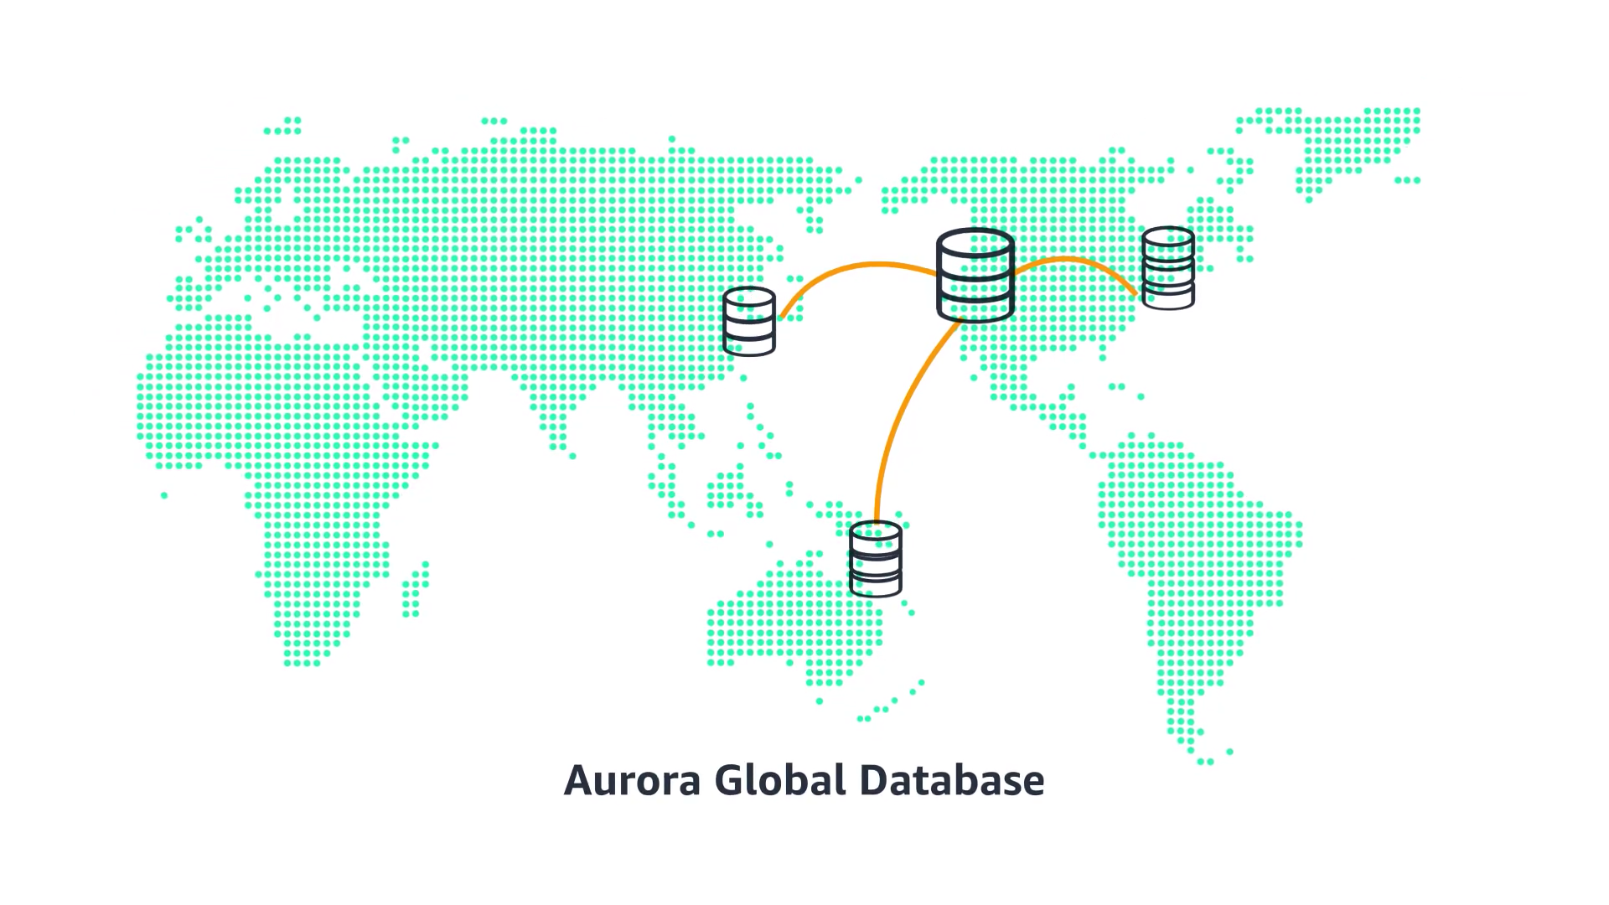

Slide 14
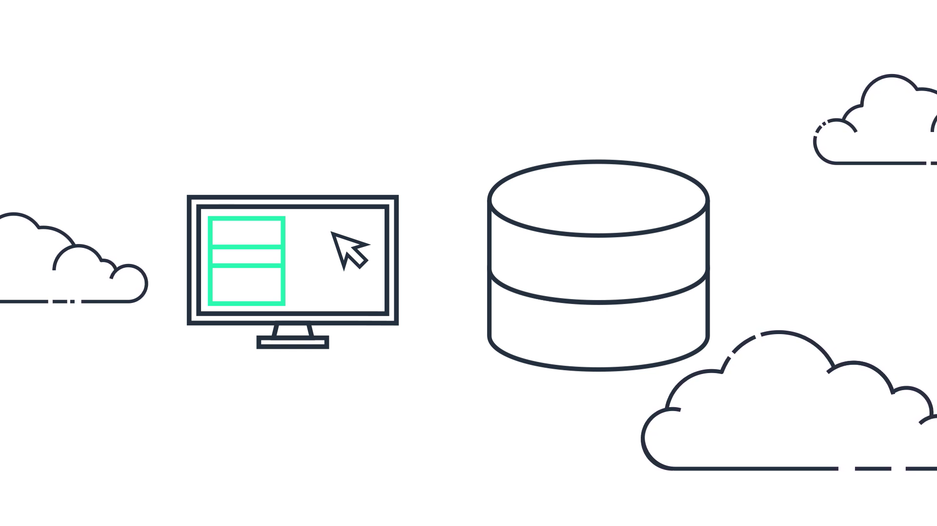

Slide 15
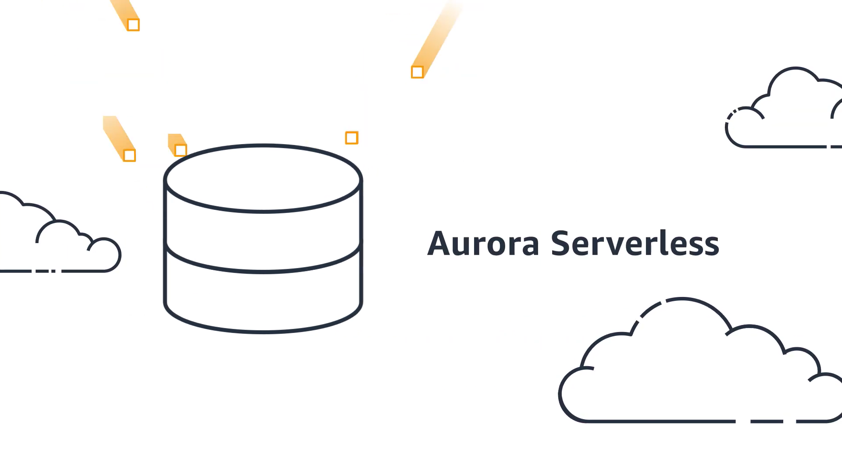

Slide 16
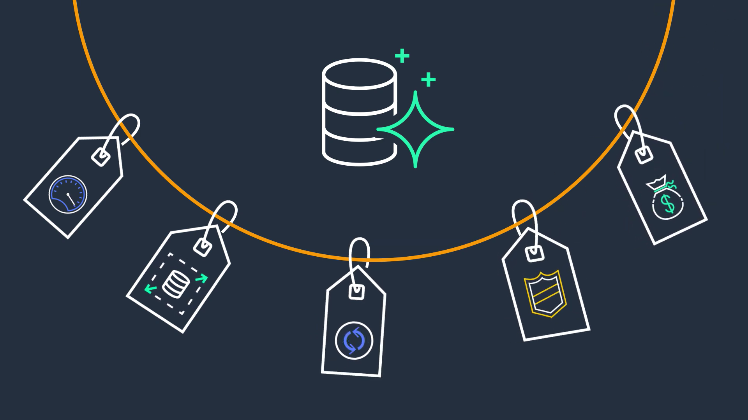

Slide 17
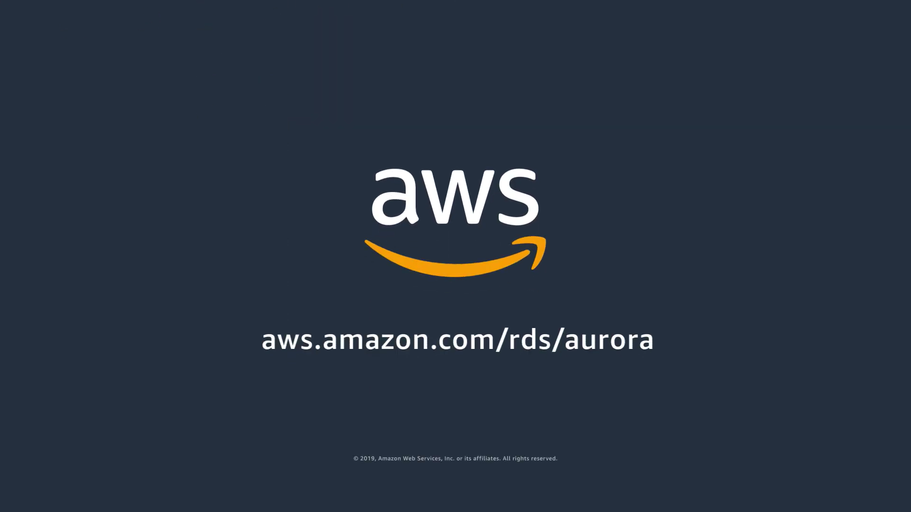

Slide 18
All the information and images taken and edited from –
https://www.youtube.com/watch?v=FzxqIdIZ9wc

Slide 19
Information(Theory)
Amazon Aurora is a MySQL and PostgreSQL-compatible relational database built for the cloud, that combines the performance and availability of traditional enterprise databases with the simplicity and cost-effectiveness of open source databases.
Amazon Aurora is up to five times faster than standard MySQL databases and three times faster than standard PostgreSQL databases. It provides the security, availability, and reliability of commercial databases at 1/10th the cost. Amazon Aurora is fully managed by Amazon Relational Database Service (RDS), which automates time-consuming administration tasks like hardware provisioning, database setup, patching, and backups.
Amazon Aurora features a distributed, fault-tolerant, self-healing storage system that auto-scales up to 128TB per database instance. It delivers high performance and availability with up to 15 low-latency read replicas, point-in-time recovery, continuous backup to Amazon S3, and replication across three Availability Zones (AZs).
Visit the Amazon RDS Management Console to create your first Aurora database instance and start migrating your MySQL and PostgreSQL databases.
https://aws.amazon.com/rds/aurora/?aurora-whats-new.sort-by=item.additionalFields.postDateTime&aurora-whats-new.sort-order=desc

Slide 20
Performance
Amaan Naikwadi - 23363

Slide 21
Factors affecting the performance of a Database System:
At a high level, database performance can be defined as the rate at which a database management system (DBMS) supplies information to users.
The factors which affect the performance of Database System are –
Workload
Throughput
Resources
Optimization
Contention

Slide 22
1.Workload
Workload is the activity the DBMS is requested to perform, which drives the processing demands placed on the system. Workload can fluctuate drastically by day, hour or even minute. Sometimes it's steady and predictable, but at other times it can spike, such as a heavy transaction workload in Diwali for a database supporting a retailer's e-commerce site.
Amazon aurora allows you to create custom endpoints. This allows you to distribute and load balance workloads across different sets of database instances in your Aurora cluster. When you create a custom endpoint, you can specify which instances are covered by it, and you can configure whether to automatically add newly created instances in the cluster to your custom endpoint. You can also add or delete instances from the endpoint at any time. It provides up to five times better performance than the typical MySQL database and three times better than PostgreSQL, together with increased scalability, durability, and security.

Slide 23
2. Throughput
Throughput is a measurement of a system's ability to process data. It's a composite of I/O and CPU speed, and it can be affected by the parallel capabilities of the database server and the efficiency of the operating system and system software.
Amazon Aurora provides up to 3X Higher Throughput than PostgreSQL.
Testing on standard benchmarks has shown up to a 3x increase in throughput performance over stock PostgreSQL 9.6 on similar hardware. Amazon Aurora uses a variety of software and hardware techniques to ensure the database engine is able to fully leverage available compute, memory and networking. I/O operations use distributed systems techniques such as *quorums to improve performance consistency.
*quorums - A quorum is the minimum number of votes that a distributed transaction has to obtain in order to be allowed to perform an operation in a distributed system.

Slide 24
3. Resources
Resources are the hardware and software tools at the disposal of the system -- such as database kernel, disk space, memory, cache controllers and microcode. The performance of accessing and modifying data in the database can be improved by the proper allocation and application of resources.

Slide 25
4. Optimization
Optimization speeds up query performance. All types of systems can be optimized, but relational databases are unique in that query optimization is primarily accomplished internal to the DBMS.
Aurora offers a high-performance storage subsystem, with its MySQL- and PostgreSQL-compatible database engines customized to leverage rapid distributed storage. To accommodate changing requirements, the underlying storage system scales up automatically when necessary, up to 64 TB. Aurora can automate and standardize database clustering and replication, which are among the most difficult aspects of database administration, configuration, and management.

Slide 26
5. Contention
Contention results when the demand for a particular system resource is high, for example, if two or more components of the workload are attempting to use a single resource in a conflicting way, such as dual updates to the same piece of data. As contention increases, throughput decreases.
Hot row Contention provides up to 16x throughput improvement in transactions per minute relative to MySQL 5.7 when there are many transactions contending for the rows on the same page.

Slide 27
Advantages:
Yash Patwardhan - 23361

Slide 28
High Performance and Scalability
Get 5X the throughput of standard MySQL and 3X the throughput of standard PostgreSQL.
Easily scale your database deployment up and down from smaller to larger instance types as your needs change.
Amazon Aurora automatically grows storage as needed, up to 128TB per database instance.

Slide 29
High Availability and Durability
Amazon Aurora is designed to offer greater than 99.99% availability, replicating 6 copies of your data across 3 Availability Zones and backing up your data continuously to Amazon S3.
It transparently recovers from physical storage failures; instance failover typically takes less than 30 seconds.
You can also backtrack within seconds to a previous point in time, to recover from user errors.

Slide 30
Highly Secure
Amazon Aurora provides multiple levels of security for your database.
These include network isolation using Amazon VPC, encryption at rest using keys you create and control through AWS Key Management Service (KMS) and encryption of data in transit using SSL.
On an encrypted Amazon Aurora instance, data in the underlying storage is encrypted, as are the automated backups, snapshots, and replicas in the same cluster.

Slide 31
MySQL and PostgreSQL Compatible
The Amazon Aurora database engine is fully compatible with existing MySQL and PostgreSQL open source databases, and adds compatibility for new releases regularly.
This means you can easily migrate MySQL or PostgreSQL databases to Aurora using standard MySQL or PostgreSQL import/export tools or snapshots.
The code, applications, drivers, and tools you already use with your existing databases can be used with Amazon Aurora with little or no change.

Slide 32
Fully Managed
Amazon Aurora is fully managed by Amazon Relational Database Service (RDS).
No longer need to worry about database management tasks such as hardware provisioning, software patching, setup, configuration, or backups. Aurora automatically and continuously monitors and backs up your database to Amazon S3, enabling granular point-in-time recovery.
You can monitor database performance using Amazon CloudWatch, Enhanced Monitoring, or Performance Insights, an easy-to-use tool that helps you quickly detect performance problems.

Slide 33
Migration Support
MySQL and PostgreSQL compatibility make Amazon Aurora a compelling target for database migrations to the cloud.
To migrate from commercial database engines, you can use the AWS Database Migration Service for a secure migration with minimal downtime.

Slide 34
Disadvantages

Slide 35
The source code is not available.
It's protocol compatible with mysql-5.6.10 - so if you need features in newer or older versions of MySQL you can't assume that Amazon will bring new MySQL features in a few months with a newer version of MySQL in RDS.
You cannot use MyISAM tables. Aurora only supports InnoDB.
You can't launch anything smaller than an r3.large with Aurora, so if you want smaller (cheaper) RDS databases, you have to use MySQL.

Slide 36
Featured Customers:

Slide 37
Enterprise Applications - Amazon Aurora is a great option for any enterprise application that can use a relational database. It helps you save time by automating time consuming tasks such as provisioning, patching, backup, recovery, failure detection, and repair.
Software as a Service (SaaS) Applications - SaaS applications often use architectures that are multi-tenant, which requires a great deal of flexibility in instance and storage scaling along with high performance and reliability.
Web and Mobile Gaming - Web and mobile games that are built to operate at very large scale need a database with high throughput, massive storage scalability, and high availability.

Slide 38
Use Cases (Application)
Vedant Deshpande - 23362

Slide 39
Enterprise Applications
Compared to commercial databases, Amazon Aurora can help cut down your database costs by 90% or more while improving reliability and availability of the database.
Amazon Aurora being a fully managed service helps you save time by automating time consuming tasks such as provisioning, patching, backup, recovery, failure detection, and repair.

Slide 40
Software as a Service (SaaS) Applications
SaaS applications often use architectures that are multi-tenant, which requires a great deal of flexibility in instance and storage scaling along with high performance and reliability.
Amazon Aurora provides all of these features in a managed database, helping SaaS companies focus on building high quality applications without worrying about the underlying database that powers the application

Slide 41
Web and Mobile Gaming
Web and mobile games that are built to operate at very large scale need a database with high throughput, massive storage scalability, and high availability.
Amazon Aurora fulfills the needs of such highly demanding applications with enough room for future growth.
Since Amazon Aurora does not have any licensing constraints, it perfectly fits the variable usage pattern of these applications.

Slide 42
Featured Customers
DoorDash – Largest third-party delivery service in the world which makes over 800,000 deliveries a day.
Samsung – Samsung Account application, which uses Amazon Aurora, supports more than 1 billion users, who on average make 80,000 requests per second.
Pokemon Company – Supports 300+ million users including 300 login requests per second.
Autodesk, Cognizant, Netflix, United Nations and various other organizations also use Amazon Aurora.
https://www.youtube.com/watch?v=FzxqIdIZ9wc

Slide 43


